Slide 1
Operating System Fundamentals
Computer Engineering
Notes:
Introduction to the presentation on Operating System Fundamentals.

Slide 2
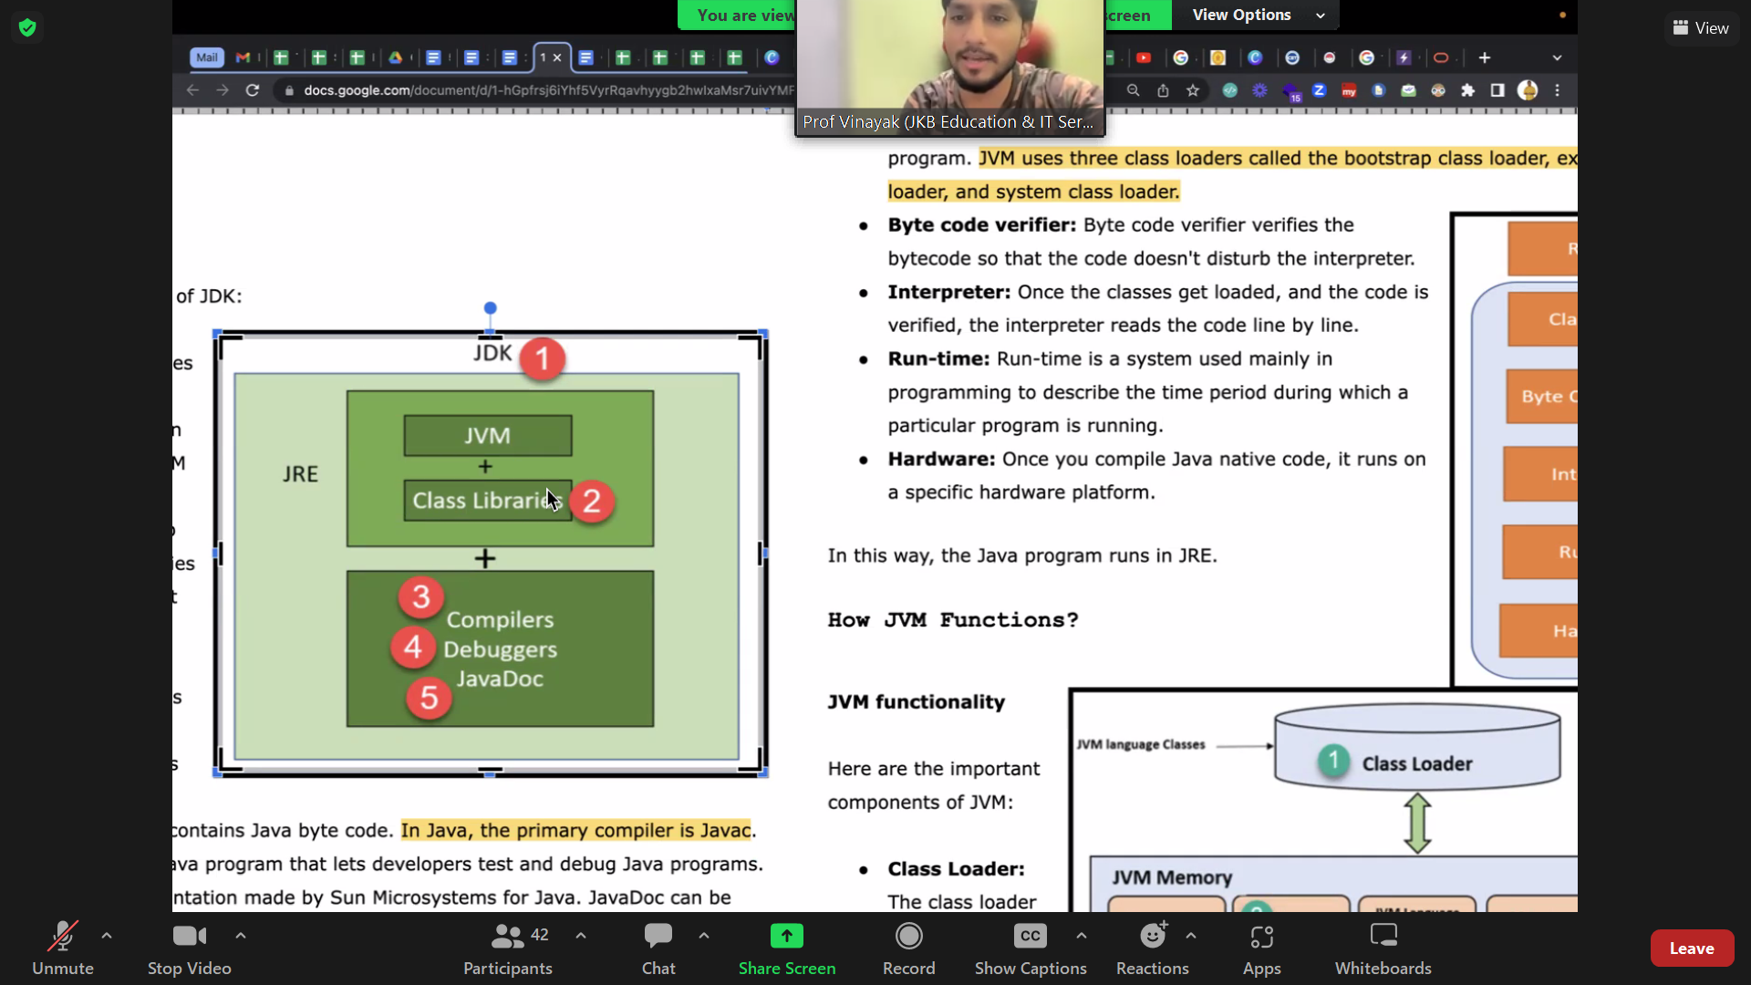
Introduction to Operating Systems
Operating systems manage computer hardware and software resources efficiently and effectively always
Acts as an intermediary between computer hardware and user-level applications providing services
Provides a platform for running applications and managing computer hardware components seamlessly
Manages primary memory and storage devices to optimize system performance and productivity
Handles input output operations and interrupts to ensure smooth system functioning and responsiveness
Ensures system security and stability by implementing access control and authentication mechanisms
Supports multitasking and multithreading to increase system throughput and user productivity
Provides a user interface for interacting with the system and executing commands efficiently
Manages file systems and directories to store and retrieve data securely and reliably
Optimizes system performance by managing processes and threads and allocating resources effectively
Notes:
Present Introduction to Operating Systems in the context of Operating System Fundamentals.

Slide 3
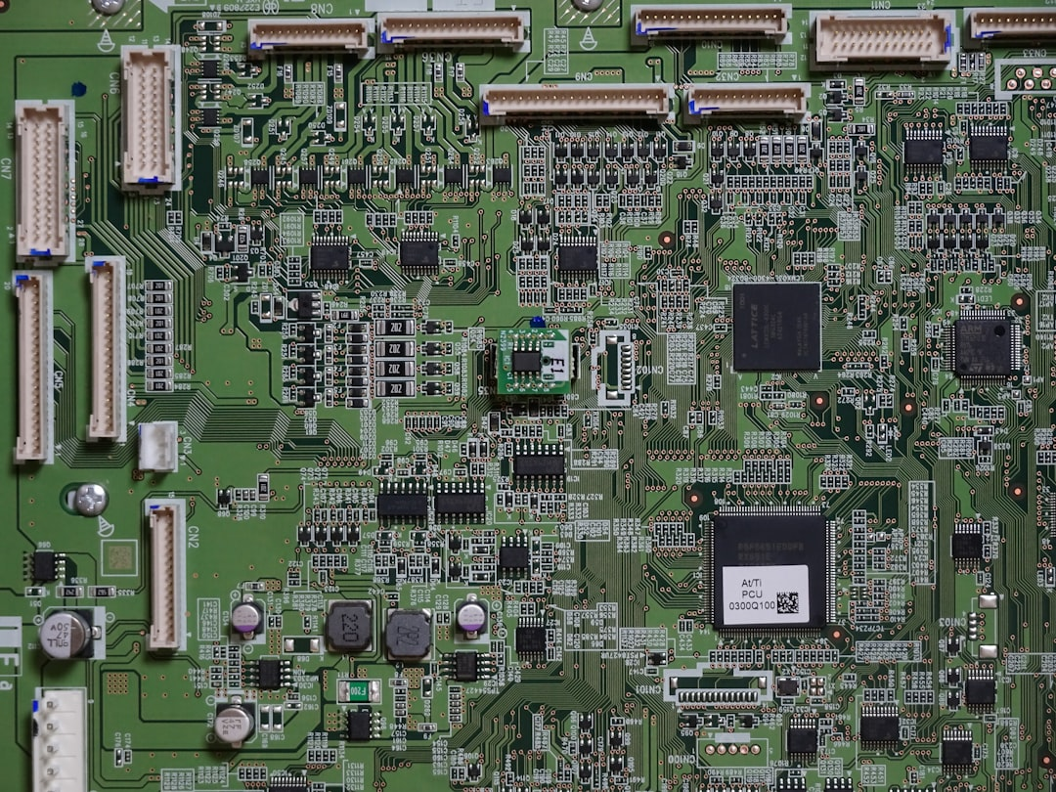
Process Management Concepts
A process is a program in execution with its own memory space.
Process scheduling determines which process runs at a given time.
Notes:
Present Process Management Concepts in the context of Operating System Fundamentals.

Slide 4
Memory Management Techniques
Paging technique divides memory into fixed-size blocks for efficient allocation
Segmentation method divides memory into variable-size blocks for better utilization
Virtual memory combines physical and secondary storage for increased capacity
Swapping technique involves exchanging processes between main and secondary memory
Memory fragmentation occurs when free memory is broken into small unusable blocks
Memory compaction technique rearranges memory to eliminate fragmentation and improve allocation
Cache memory stores frequently accessed data for faster retrieval and execution
Memory protection mechanisms prevent unauthorized access to sensitive data and programs
Memory allocation algorithms manage memory distribution among competing processes and threads
Notes:
Present Memory Management Techniques in the context of Operating System Fundamentals.

